Slide 1

MOBILE APPLICATION BASED ON AR
MANOJ R.D
124006059
EIE / SEEE
HARI HARAN M.V
124006058
EIE / SEEE
Dr. GHOUSIYA BEGUM K
Asst. Professor
EIE / SEEE
SASTRA Deemed University

Slide 2
Presentation Outline
Abstract
Block Diagram
Methodology used
Timeline Activity
Output
Work on hand tracking
Reference

Slide 3
ABSTRACT:
This project focuses on developing a mobile augmented reality (AR) application that integrates computer vision(CV) technology and can also control things in the Internet of Things (IoT). The goal of the project is to enhance the user's AR experience by providing advanced object recognition and classification capabilities. The application uses the camera on the mobile device to capture images of real-world objects and uses CV algorithms to identify and classify the objects in real-time. Also, this application can control things virtually.
Overall, this project demonstrates the potential of integrating CV technology and IoT into AR applications to create new and exciting user experiences .

Slide 4
BLOCK DIAGRAM:
(IOT) THING
CLOUD
API FOR TRIGGERING
SCRIPT
UI
REFERENCE
FROM THE REAL-WORLD
CORESPONDING DETAILS
OVERLAY
INFO

Slide 5
METHODOLOGY USED:
Software used:
Unity
Vuforia
PyCharm
Visual studio

Slide 6
TIMELINE ACTIVITY:
Designing an application with could control things.
Code an Script for hand recognition.
Integrate CV script with unity .
Design an IOT based auto machine.
Controlling things with gestures.

Slide 7
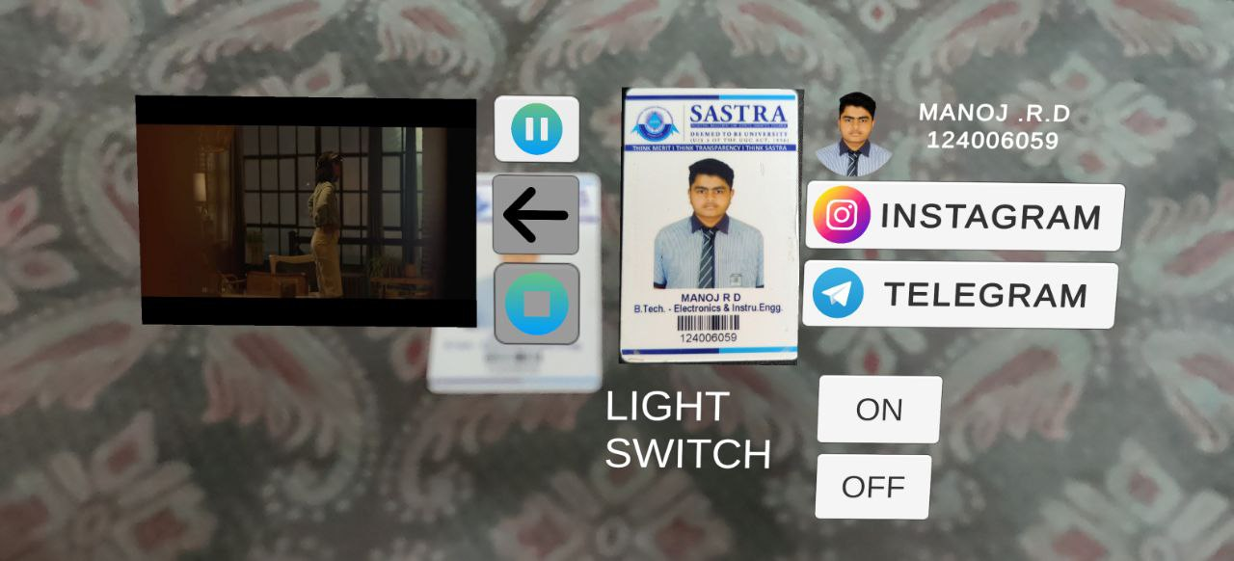
OUTPUT:

Slide 8
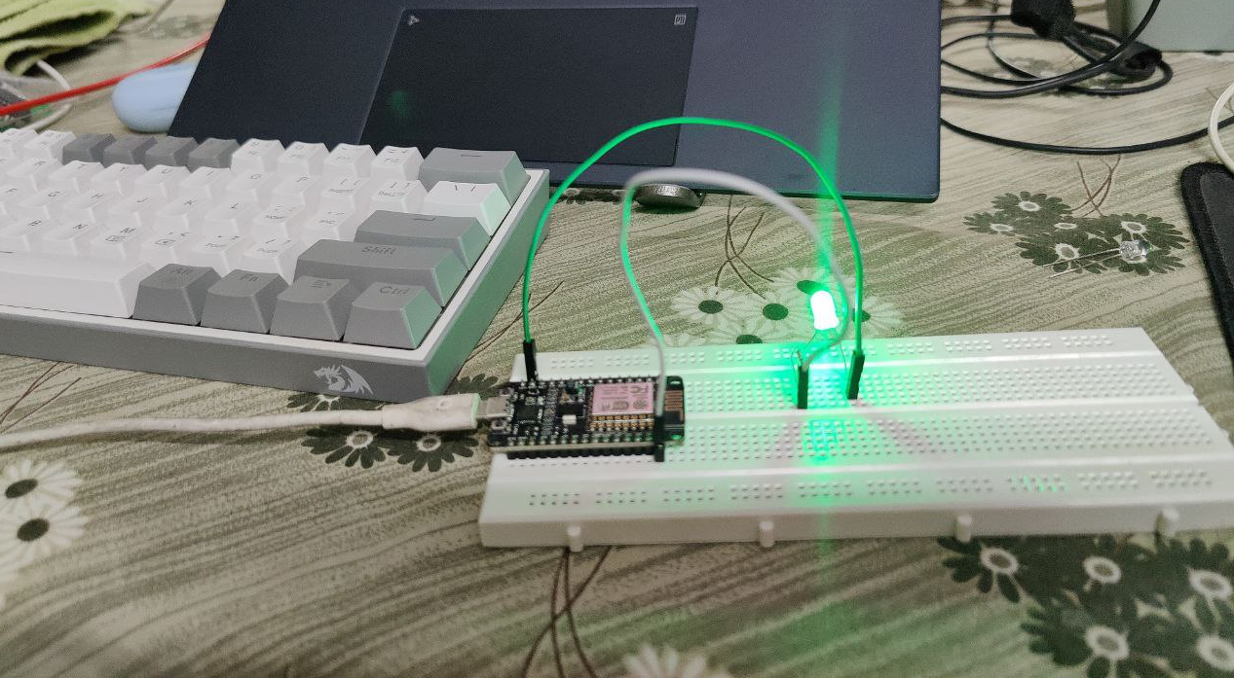
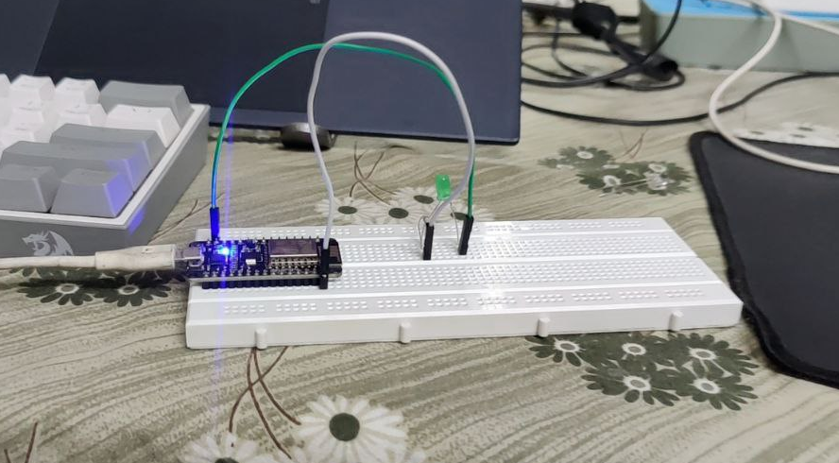
OUTPUT:

Slide 9
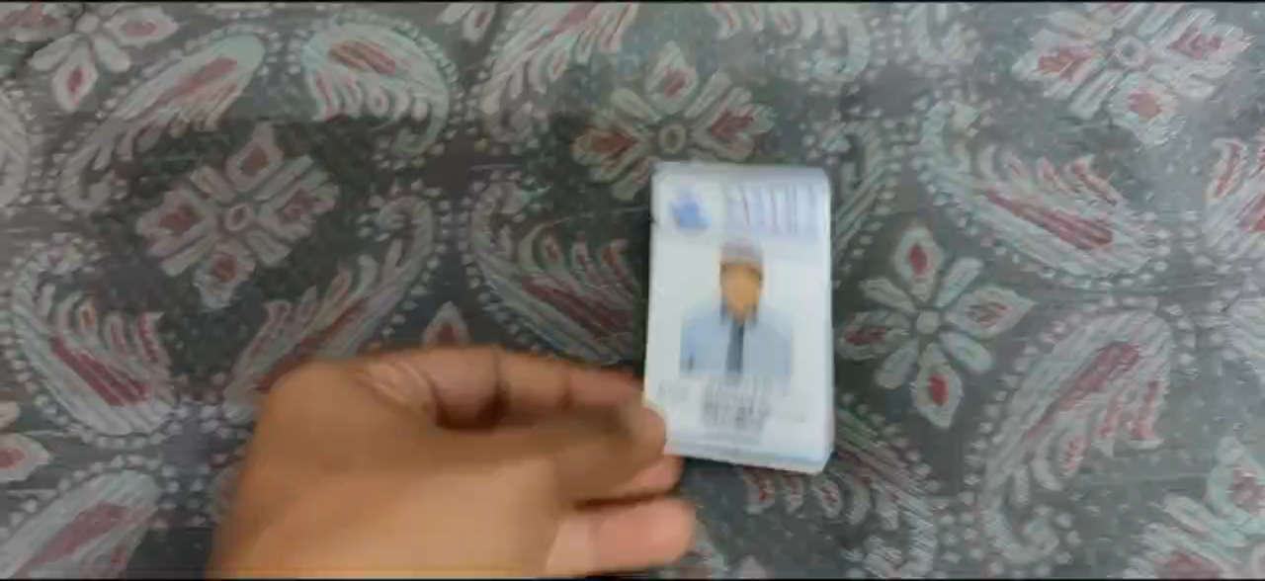
OUTPUT :

Slide 10
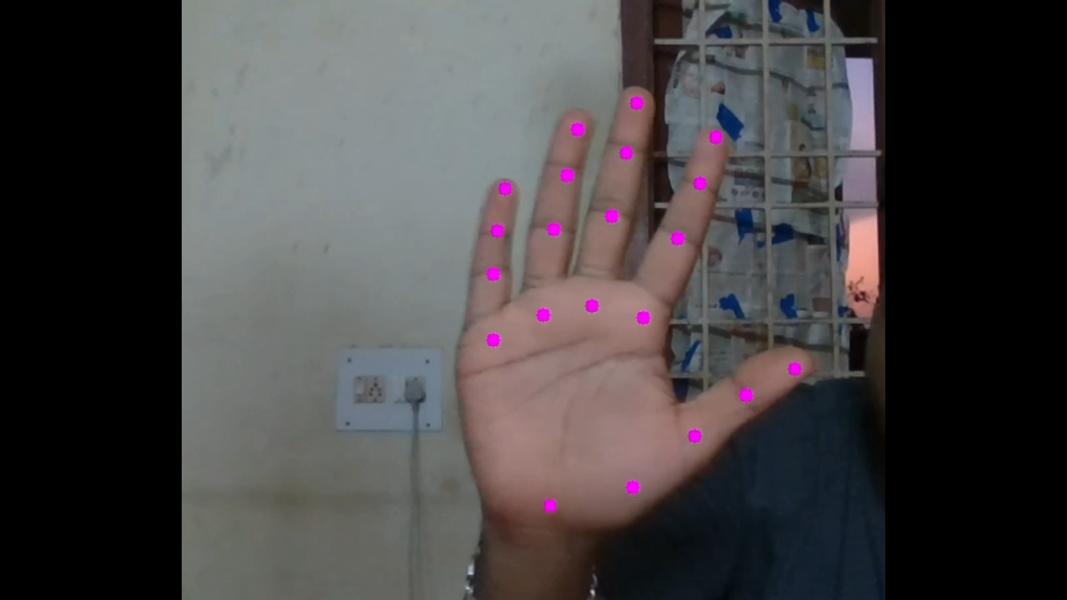
OUTPUT :

Slide 11
REFERENCE:
https://www.researchgate.net/publication/320704050_AUGMENTED_REALITY_IN_MOBILE_DEVICES
Augmented Reality – Layar Reality Browser [online] Available: http://www.layar.com/.

